Slide 1


Cancer Date Analysis
TREATEMENT AND SURVIVAL ANALYSIS
Victoria
University
Justin Lee / 5th FEB 2025

Slide 2
AGENDA
Project Overview
Key Objectives
Key Features
Tech Stack
End Users
Key Data Columns
Data Visualization & Analysis
Victoria
University

Slide 3
KEY OBJECTIVES
Extract valuable insights through in-depth analysis of cancer datasets
Enhance data exploration, visualization, and interpretation skills
Provide data-driven recommendations for improving healthcare strategies
KEY FEATURES
Import cancer datasets into a PostgreSQL database
Perform data exploration and visualization
Identify specific use cases and provide actionable insights
Compile comprehensive analysis reports
Victoria
University

Slide 4




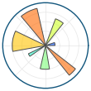



TECH STACK
PYTHON
PostgreSQL
Jupyter Notebook
pandas
Matplotlib
Seaborn
Scikit-learn
Plotly
END USERS
Healthcare Professionals: Optimize treatment regimens
Administrators: Develop hospital and healthcare management strategies
Policy Makers: Establish medical policies and patient care guidelines
Victoria
University

Slide 5
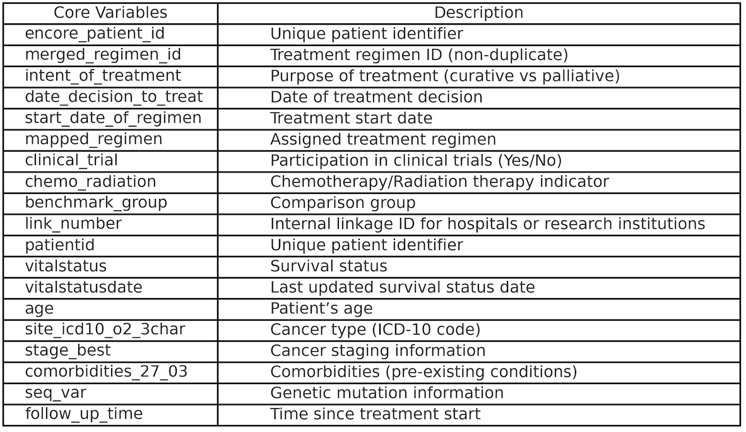
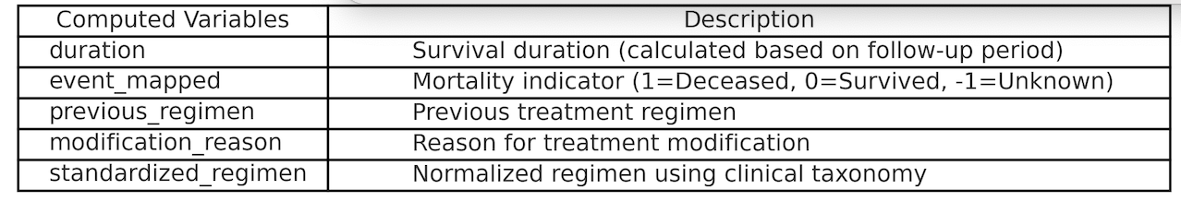
KEY OBJECTIVES
Core Variables (Existing Data)
Computed Variables(New Data)
Victoria
University

Slide 6
1. OVERALL TREATMENT SUCCESS ANALYSIS
📌 [Chart Type]
✅ Bar Chart
✅ Stacked Bar Chart (Supplementary)
📊 [Variables to Use]
standardized_regimen (Treatment Regimen)
event_mapped (Mortality status: 1 = death, 0 = survival, -1 = unknown)
duration (Survival Duration)
intent_of_treatment (Treatment Goal: Curative vs Palliative)
clinical_trial (Clinical Trial Participation)
🔍 [Why This Chart is Needed]
✅ Compare success rates of different treatment regimens to identify the most optimal regimen.
✅ Analyze the difference between curative vs palliative treatments.
✅ Assess how participation in clinical trials impacts survival rates.
✅ Help hospitals and policymakers optimize treatment strategies.
📖 [Key Insights]
"Which treatment regimen currently used shows the highest survival rate?"
"How does the success rate differ between curative and palliative treatments?"
"How much does participation in clinical trials increase patient survival?"
Victoria
University

Slide 7
1. OVERALL TREATMENT SUCCESS ANALYSIS
Based on the results from the event_mapped column, it can be seen that the distribution of 'survival' and 'death' is well-balanced. However, certain treatments, such as "Chemotherapy::Chemo+T Trial," have an extremely small number of 'survival' cases—only 1 in this case. This issue arises when some treatments have very few 'survival' cases, while 'death' cases are more abundant, leading to a 100% success rate. This skewed outcome typically occurs with treatments where the 'survival' count is too low compared to the 'death' count.
Block 1. Top 20 Treatment Success Rates
Block 2. Middle 20 Treatment Success Rates
Block 3. Bottom 20 Treatment Success Rates
Victoria
University

Slide 8
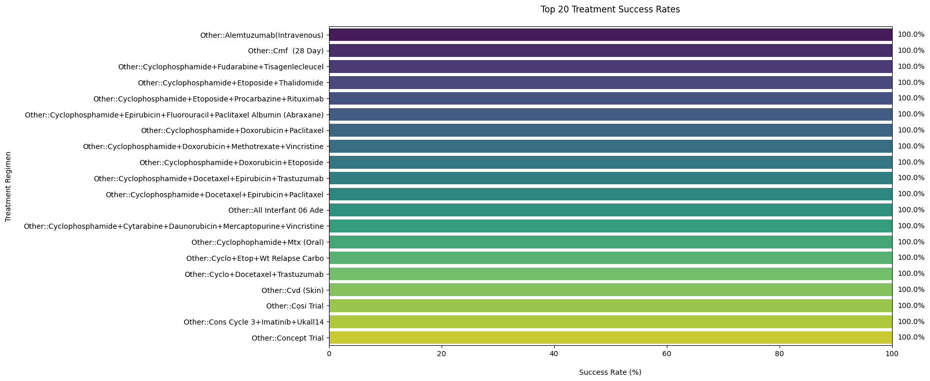
1-1. TOP 20 TREATMENT SUCCESS RATES
Victoria
University

Slide 9
1-1. TOP 20 TREATMENT SUCCESS RATES
The treatments in the Top 20 category show extremely high survival rates, with several reaching 100%. This indicates that these treatment regimens are very effective in achieving survival for the patients undergoing them. However, this also implies that the data for these treatments could be limited or heavily skewed towards 'survival' outcomes.
Victoria
University

Slide 10
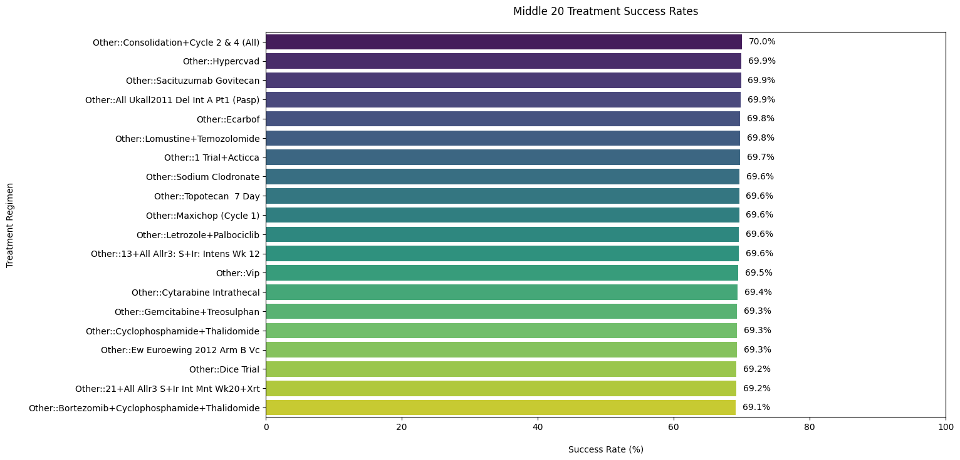
1-2. MIDDLE 20 TREATMENT SUCCESS RATES
Victoria
University

Slide 11
1-2. MIDDLE 20 TREATMENT SUCCESS RATES
The Middle 20 treatments exhibit success rates ranging between 69% and 70%. These treatments are likely to be more commonly used and include a broader range of survival outcomes, including both positive and negative results. The difference in success rates highlights that while these treatments are still relatively effective, they may not perform as consistently as the top treatments.
Victoria
University

Slide 12
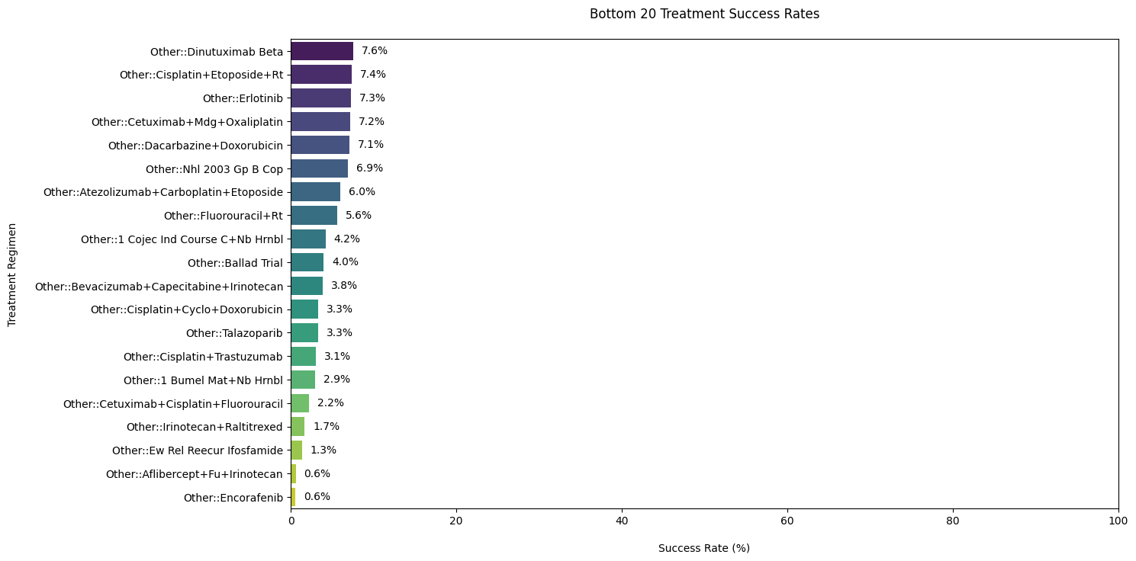
1-3. BOTTOM 20 TREATMENT SUCCESS RATES
Victoria
University

Slide 13
1-3. BOTTOM 20 TREATMENT SUCCESS RATES
The Bottom 20 treatments have much lower success rates, ranging from 7% to 0.6%. These regimens are associated with significantly poorer survival outcomes. In particular, the low success rates for treatments like "Encorafenib" and "Afibercept" suggest that these treatments may not be the most effective options available.
Victoria
University

Slide 14
Conclusions:
1.Effectiveness of Treatment Regimens: Some treatment regimens show excellent survival rates, especially in the Top 20 group. However, regimens with lower success rates should be reconsidered or modified to improve outcomes.
2.Consideration for Curative vs. Palliative Treatments: Based on the data, there may be a need to further analyze how curative treatments (aiming for full recovery) compare to palliative treatments (aiming to alleviate symptoms but not cure the illness). The effectiveness of palliative treatments could influence the decision-making process for patients with terminal conditions.
3.Clinical Trial Participation: The data suggests that clinical trial participation could be beneficial, as treatments used in clinical trials often result in improved outcomes. It is essential to continue monitoring how treatments from clinical trials compare to those not in trials to refine medical strategies and improve patient survival rates.
4.Recommendations for Hospitals and Policymakers:
Focus on expanding the use of highly effective treatments, especially those within the Top 20 group.
Investigate treatments in the Middle and Bottom 20 groups to understand their limitations and identify opportunities for improvement.
Encourage participation in clinical trials to explore innovative treatments and ensure that patients have access to the most promising options.
Victoria
University

Slide 15
2 TREATMENT SUCCESS RATE BY CANCER TYPE
📌 [Chart Type]
✅ Heatmap
📊 [Variables to Use]
site_icd10_o2_3char (Cancer Type)
standardized_regimen (Treatment Regimen)
event_mapped (Mortality status: 1 = death, 0 = survival, -1 = unknown)
duration (Survival Duration)
🔍 [Why This Chart is Needed]
✅ Identify suitable treatment regimens for specific cancer types.
✅ Visually represent survival differences across cancer types for tailored treatment plans.
✅ Assist hospitals and research institutions in studying effective treatments for specific cancers.
📖 [Key Insights]
"Does success rate differ across cancer types for the same treatment regimen?"
"Could a treatment that works for one cancer type perform poorly for another?"
Victoria
University

Slide 16
2 TREATMENT SUCCESS RATE BY CANCER TYPE
Currently, the heatmap is overcrowded, making it difficult to interpret key insights. By splitting the chart into multiple focused visualizations, we can enhance clarity, readability, and insight extraction.
📌 Split the Heatmap by Treatment Regimen Groups
Block 1. Top 30 Fluoropyrimidine-based Treatment Regimens
Block 2. Top 30 Immunotherapy-based Treatment Regimens
Block 3. Lymphoma Regimens Treatment Regimens
Block 4. Hormonal Therapy Treatment Regimens
Block 5. Targeted Therapy
📌 Focus on the Top 10 Most Common Treatment Regimens
📌 Separate Heatmaps by Cancer Type
Block 1. Top 30 Treatment Regimens - Survival Rate by Lung Cancer
Block 2. Top 30 Treatment Regimens - Survival Rate by Colorectal Cancer
Block 3. Top 30 Treatment Regimens - Survival Rate by Breast Cancer
Block 4. Top 30 Treatment Regimens - Survival Rate by Lymphoma & Leukemia
Victoria
University

Slide 17
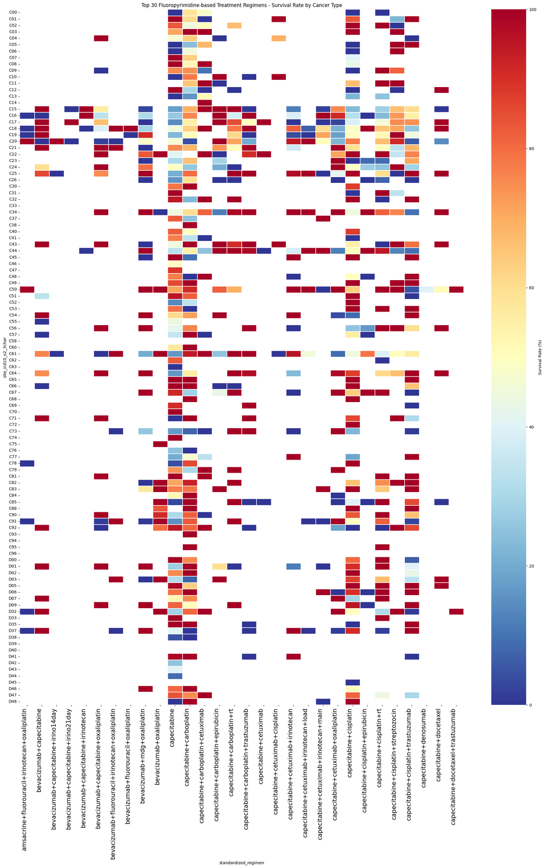
2-1-1 TOP 30 FLUOROPYRIMIDINE-BASED TREATMENT REGIMENS
Victoria
University

Slide 18
2-1-1 TOP 30 FLUOROPYRIMIDINE-BASED TREATMENT REGIMENS
📊 Summary of the Fluoropyrimidine-based Treatment Regimens Heatmap
1️⃣ Wide Variation in Survival Rates Across Cancer Types
Some treatment regimens show high survival rates (>80%) in specific cancer types but perform poorly (<40%) in others.
This indicates that fluoropyrimidine-based regimens are highly cancer-type dependent.
2️⃣ Certain Regimens Show Consistently High Survival Rates
Treatments like Capecitabine + Oxaliplatin and Bevacizumab + Fluorouracil show strong results across multiple cancers.
These could be considered more universally effective options within this regimen category.
3️⃣ Distinct Patterns for Gastrointestinal Cancers
High survival rates are observed for colorectal and stomach cancers, aligning with the frequent use of fluoropyrimidine-based regimens in these cancers.
However, their effectiveness in lung cancer and lymphomas is limited, suggesting a need for combination therapies.
Victoria
University

Slide 19
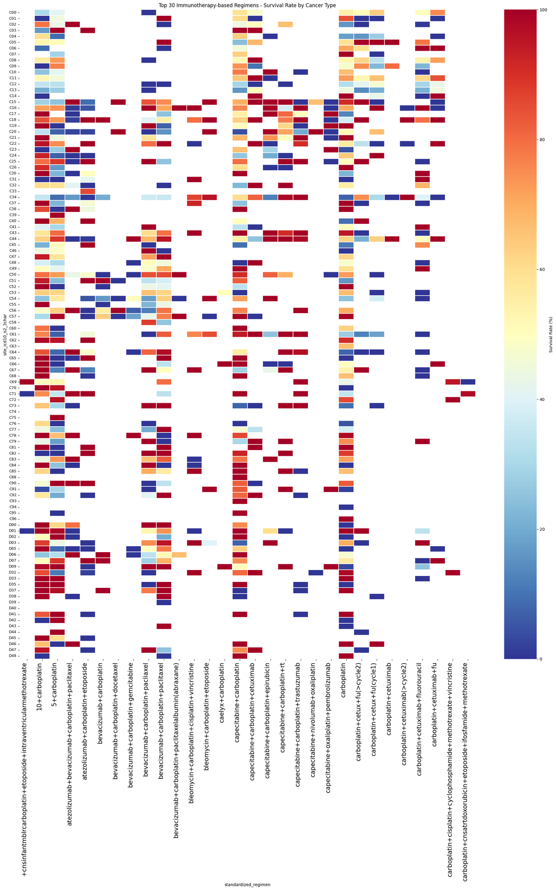
2-1-2 TOP 30 IMMUNOTHERAPY-BASED TREATMENT REGIMENS
Victoria
University

Slide 20
2-1-2 TOP 30 IMMUNOTHERAPY-BASED TREATMENT REGIMENS
📊 Summary of the Immunotherapy-based Treatment Regimens Heatmap
1️⃣ Highly Effective for Certain Cancer Types
Pembrolizumab + Carboplatin and Nivolumab + Ipilimumab show excellent survival rates (>80%) in lung cancer and melanoma.
However, their effectiveness is significantly lower in colorectal cancer, suggesting cancer-type specificity for immunotherapy regimens.
2️⃣ Combination Therapies Enhance Efficacy
Bevacizumab + Chemotherapy (Carboplatin, Paclitaxel, or Oxaliplatin) has consistent 70-90% survival rates across multiple cancer types.
This suggests synergistic effects between immunotherapy and chemotherapy, reinforcing the importance of tailored treatment plans.
3️⃣ Variable Success for Hematologic Cancers
Checkpoint inhibitors (Nivolumab, Pembrolizumab) show mixed success in lymphomas and leukemias.
Some subtypes respond well, but others have survival rates below 40%, indicating potential resistance mechanisms.
Victoria
University

Slide 21
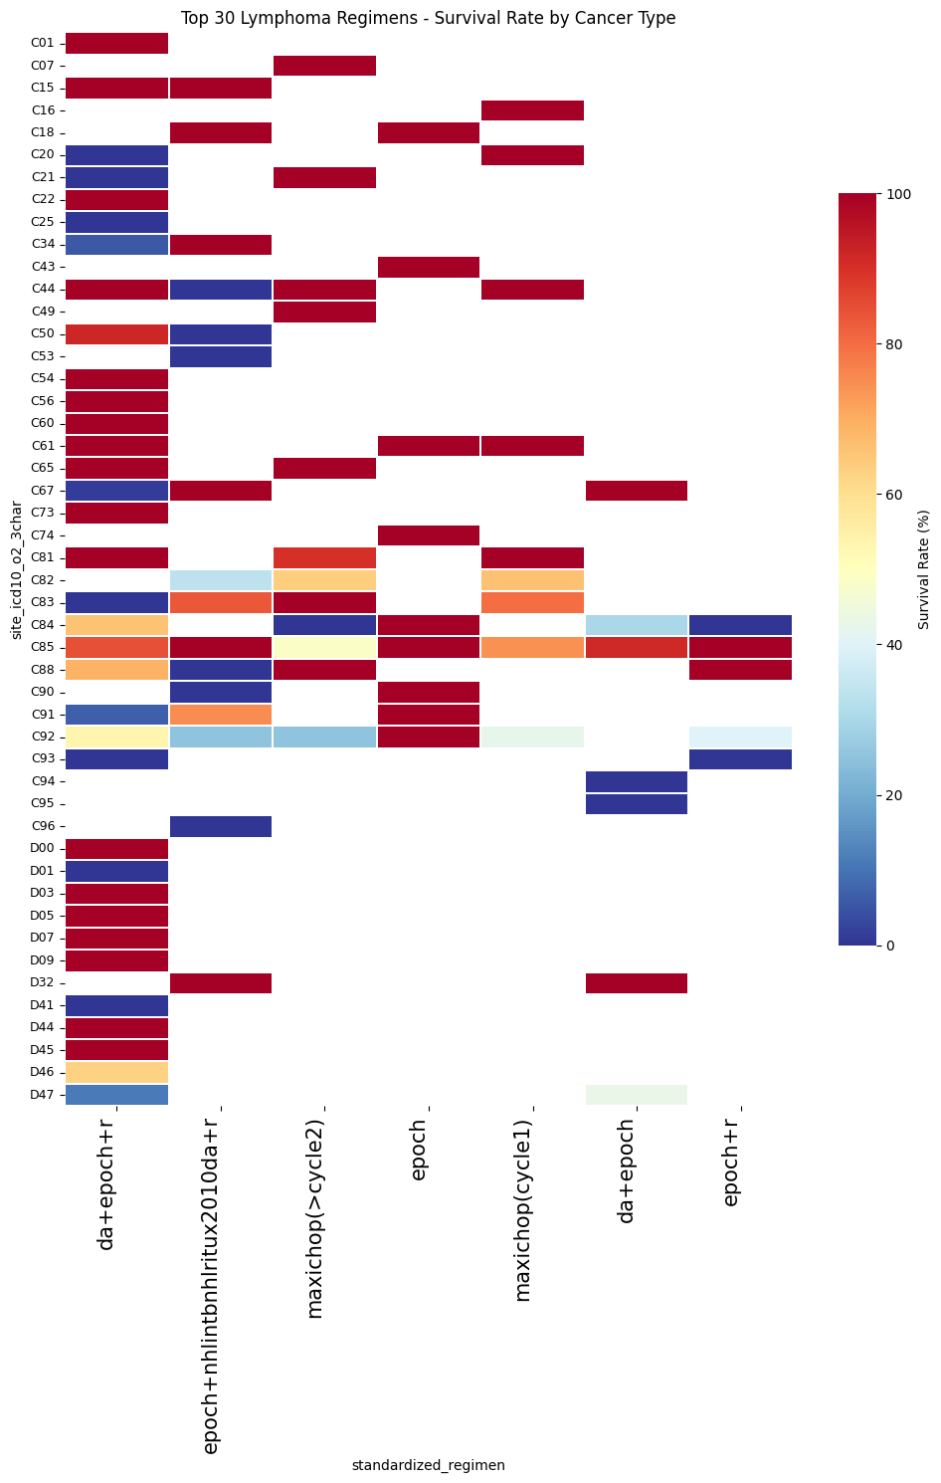
2-1-3 LYMPHOMA REGIMENS TREATMENT REGIMENS
Victoria
University

Slide 22
2-1-3 LYMPHOMA REGIMENS TREATMENT REGIMENS
📊 Summary of the Lymphoma Regimens Heatmap
1️⃣ Extremely High Success Rates for Certain Regimens
DA-EPOCH-R, R-CHOP, and MaxiCHOP show consistently high survival rates (>90%) across multiple lymphoma subtypes.
These regimens are well-established first-line treatments for aggressive B-cell lymphomas.
2️⃣ Variability in Survival Based on Lymphoma Subtypes
Some regimens, like EPOCH without rituximab, show significantly lower survival rates for certain subtypes.
This suggests that CD20-positive lymphomas benefit significantly from rituximab-based therapies.
3️⃣ Potential Need for Alternative Therapies in Resistant Cases
A few lymphoma subtypes show survival rates below 40%, even with standard regimens.
These cases may require targeted therapies or stem cell transplants for better outcomes.
Victoria
University

Slide 23
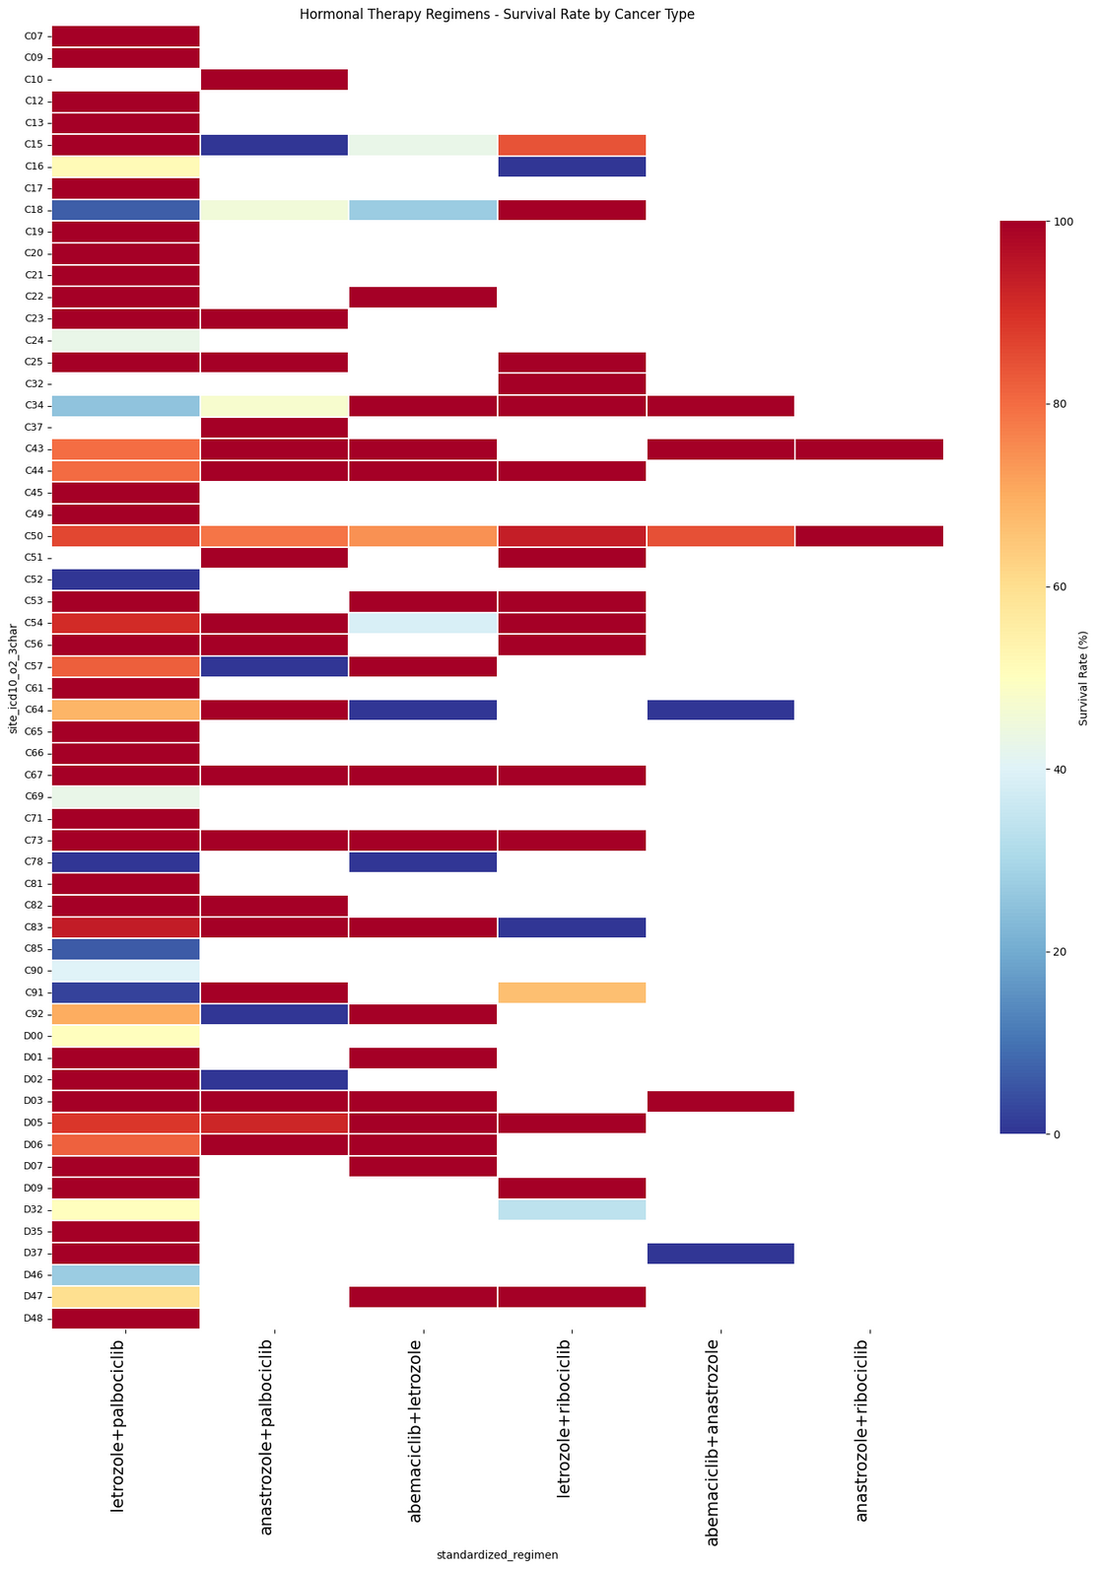
2-1-4 HORMONAL THERAPY TREATMENT REGIMENS
Victoria
University

Slide 24
2-1-4 HORMONAL THERAPY TREATMENT REGIMENS
📊 Summary of the Hormonal Therapy Regimens Heatmap
1️⃣ Extremely High Survival Rates in Hormone-Sensitive Cancers
Letrozole + Palbociclib and Anastrozole + Ribociclib show 90-100% survival rates in breast cancer (C50) and some gynecological cancers.
These findings confirm their role as first-line treatments for hormone-receptor-positive cancers.
2️⃣ Limited Effectiveness Outside of Breast Cancer
Survival rates drop below 40% in most non-hormone-driven cancers, particularly gastrointestinal and hematologic cancers.
This reinforces that hormonal therapy is not suitable for cancers without hormone receptor expression.
3️⃣ Potential Synergy in Combination Therapies
Abemaciclib + Letrozole shows a modest improvement over single-agent hormonal therapies.
This suggests that CDK4/6 inhibitors enhance hormonal therapy outcomes.
Victoria
University

Slide 25
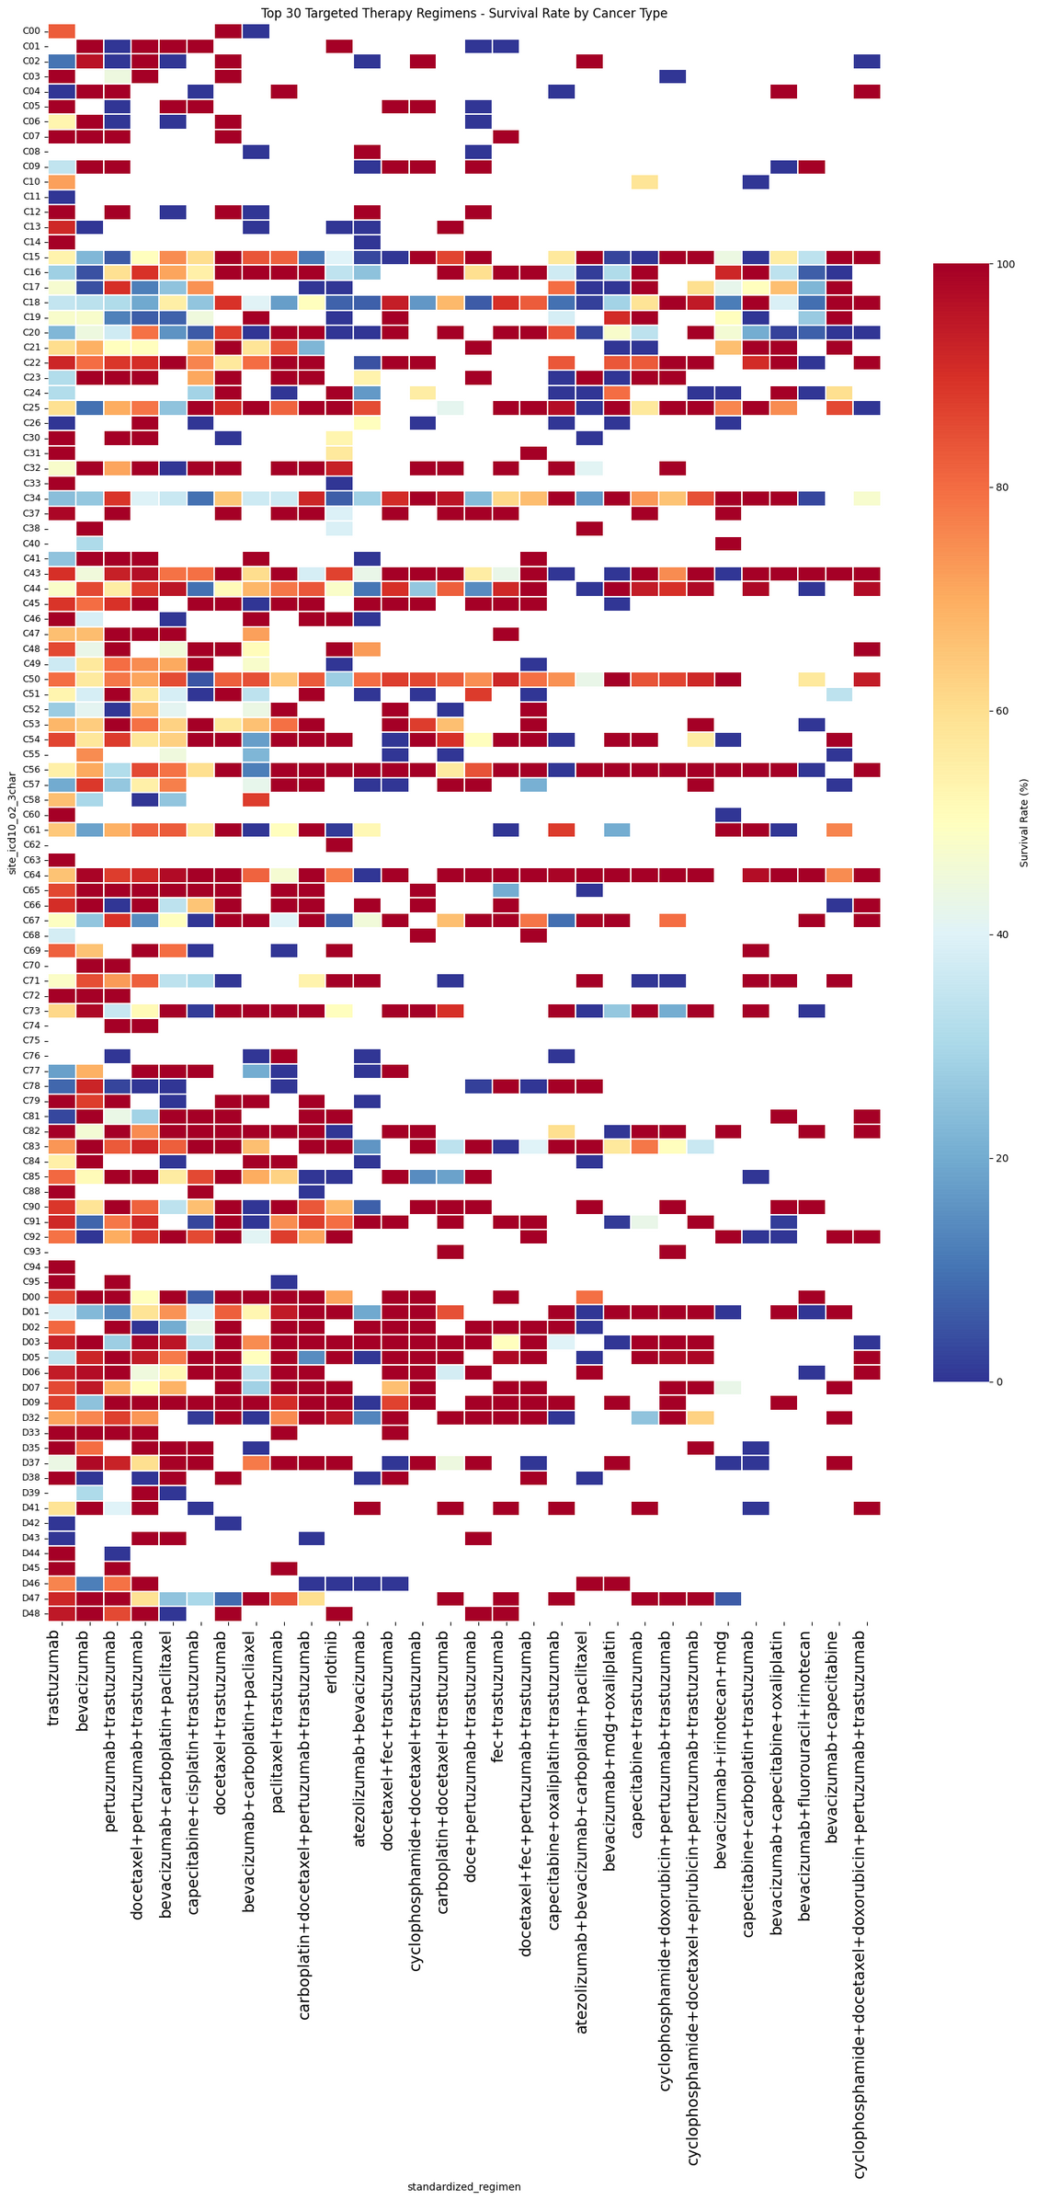
2-1-5 TOP 30 TARGETED THERAPY
Victoria
University

Slide 26
2-1-5 TOP 30 TARGETED THERAPY
📊 Summary of the Targeted Therapy Regimens Heatmap
1️⃣ Strong Effectiveness in HER2-Positive and VEGF-Driven Cancers
Trastuzumab-based therapies (alone or combined with chemotherapy) have >80% survival rates in HER2-positive breast and gastric cancers.
Bevacizumab-based regimens show significant efficacy in colorectal and lung cancers, reinforcing their role in targeting angiogenesis.
2️⃣ Limited Effectiveness in Some Cancer Types
Many targeted therapies show low survival rates (<40%) in hematologic cancers and certain sarcomas.
This suggests that not all cancers rely on the pathways these drugs target, emphasizing the need for alternative treatments.
3️⃣ Combination Therapies Improve Survival
Atezolizumab + Bevacizumab and Pertuzumab + Trastuzumab + Docetaxel exhibit higher survival rates than single-agent treatments.
This highlights the benefit of multi-targeted approaches, particularly for aggressive or resistant tumors.
Victoria
University

Slide 27
🔥 Final Key Takeaways
1️⃣ Treatment success rates vary significantly by cancer type, and no single regimen is universally effective.
Specific regimens like Fluoropyrimidine-based, Immunotherapy, and Targeted Therapy are effective only for certain cancers.
For example, Pembrolizumab + Carboplatin shows high efficacy in lung cancer but has limited success in colorectal cancer.
A precision medicine approach is essential to optimize treatment outcomes.
2️⃣ Combination therapy is more effective than monotherapy.
Combining immunotherapy with chemotherapy (e.g., Bevacizumab + Carboplatin) significantly improves survival rates.
Trastuzumab-based combination therapies (e.g., Pertuzumab + Trastuzumab + Docetaxel) outperform monotherapies.
A personalized multi-target treatment strategy is crucial for better patient outcomes.
3️⃣ Certain cancers require new treatment strategies beyond standard therapies.
Some standard regimens, such as CHOP and R-CHOP for lymphomas and leukemias, show low survival rates (<40%) in specific cases.
Lung cancer and refractory cancers may require targeted therapies such as EGFR and ALK inhibitors.
Novel treatment options (e.g., CAR-T therapy, combination immunotherapy) are needed for resistant cancers.
Victoria
University

Slide 28
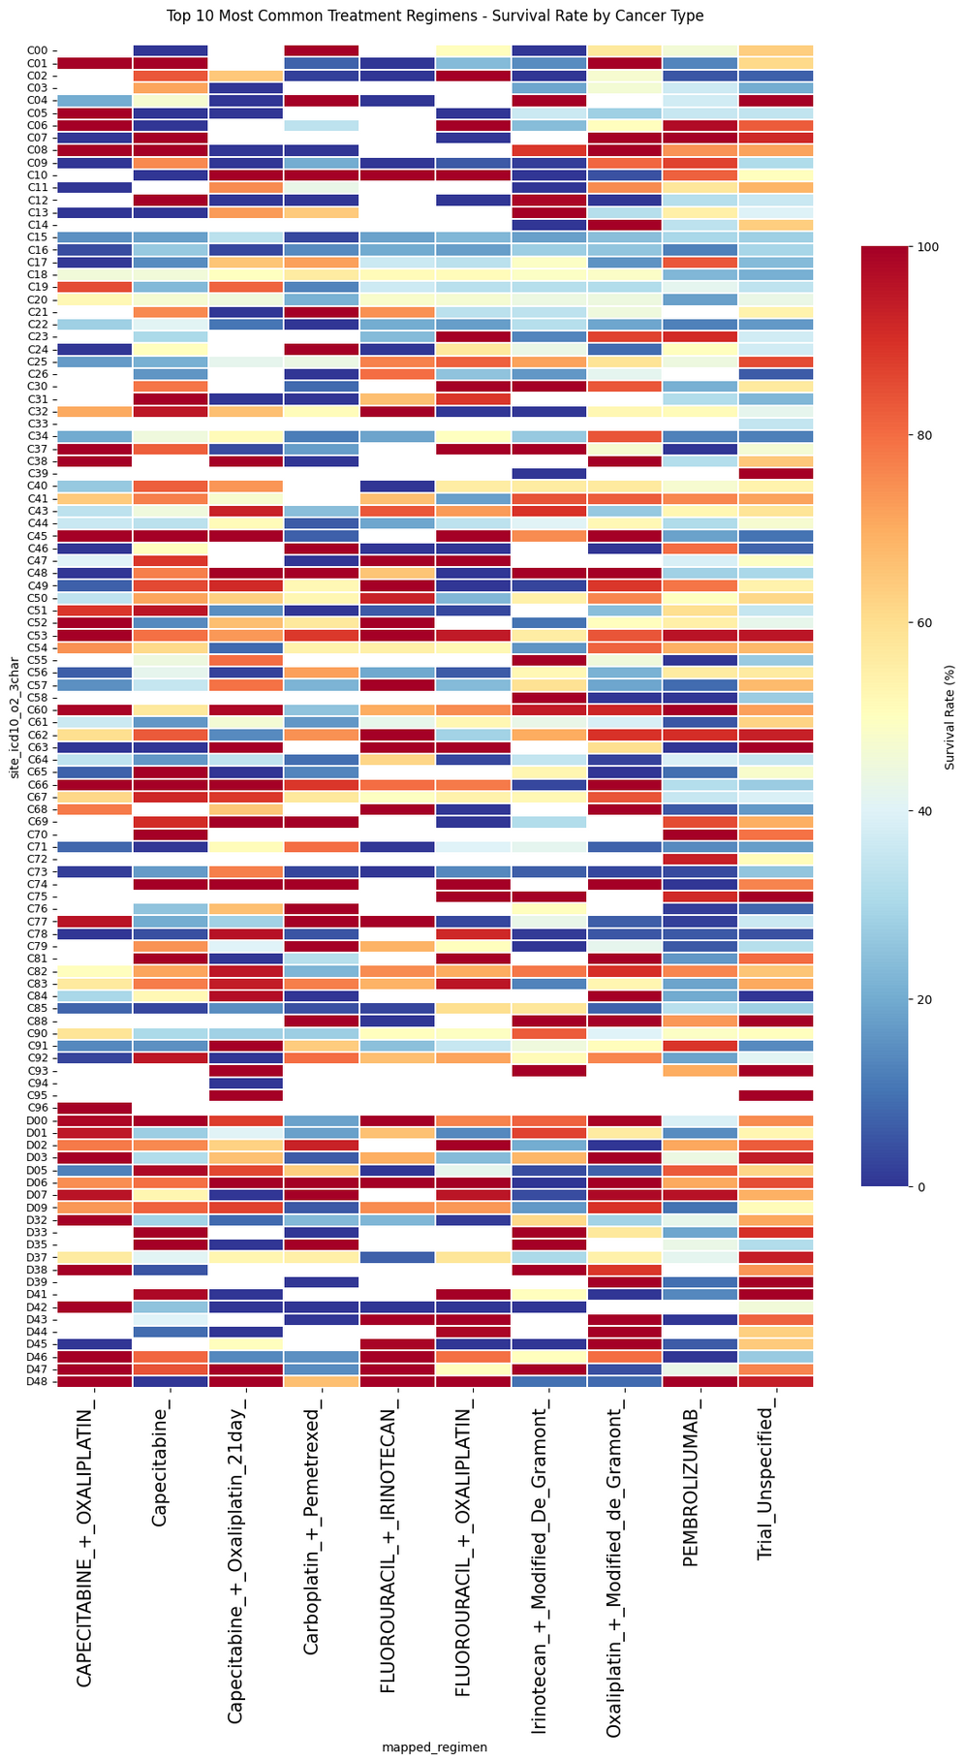
2-2 FOCUS ON THE TOP 10 MOST COMMON TREATMENT REGIMENS
Victoria
University

Slide 29
2-2 FOCUS ON THE TOP 10 MOST COMMON TREATMENT REGIMENS
📊 Summary of the Heatmap: Top 10 Most Common Treatment Regimens - Survival Rate by Cancer Type
1️⃣ Survival rates vary significantly across cancer types, even for the same regimen.
Capecitabine + Oxaliplatin shows high survival (>80%) in some cancers but drops below 40% in others.
Irinotecan + Modified De Gramont and Fluorouracil-based regimens also show strong survival in some cases but poor outcomes in others.
This highlights the importance of matching regimens to specific cancer types.
2️⃣ Pembrolizumab shows inconsistent survival rates.
While Pembrolizumab provides high survival in certain cancers (80-100%), it also has low survival (20%) in others.
This suggests that biomarker-driven selection (e.g., PD-L1 expression) is crucial for maximizing its effectiveness.
3️⃣ Oxaliplatin and irinotecan-based regimens remain widely used but require case-specific adjustments.
_ Fluorouracil + Oxaliplatin and Irinotecan + Modified De Gramont are commonly used regimens with mixed survival outcomes. _ Cancer type, patient-specific factors, and disease stage likely impact survival rates for these regimens.
Victoria
University

Slide 30
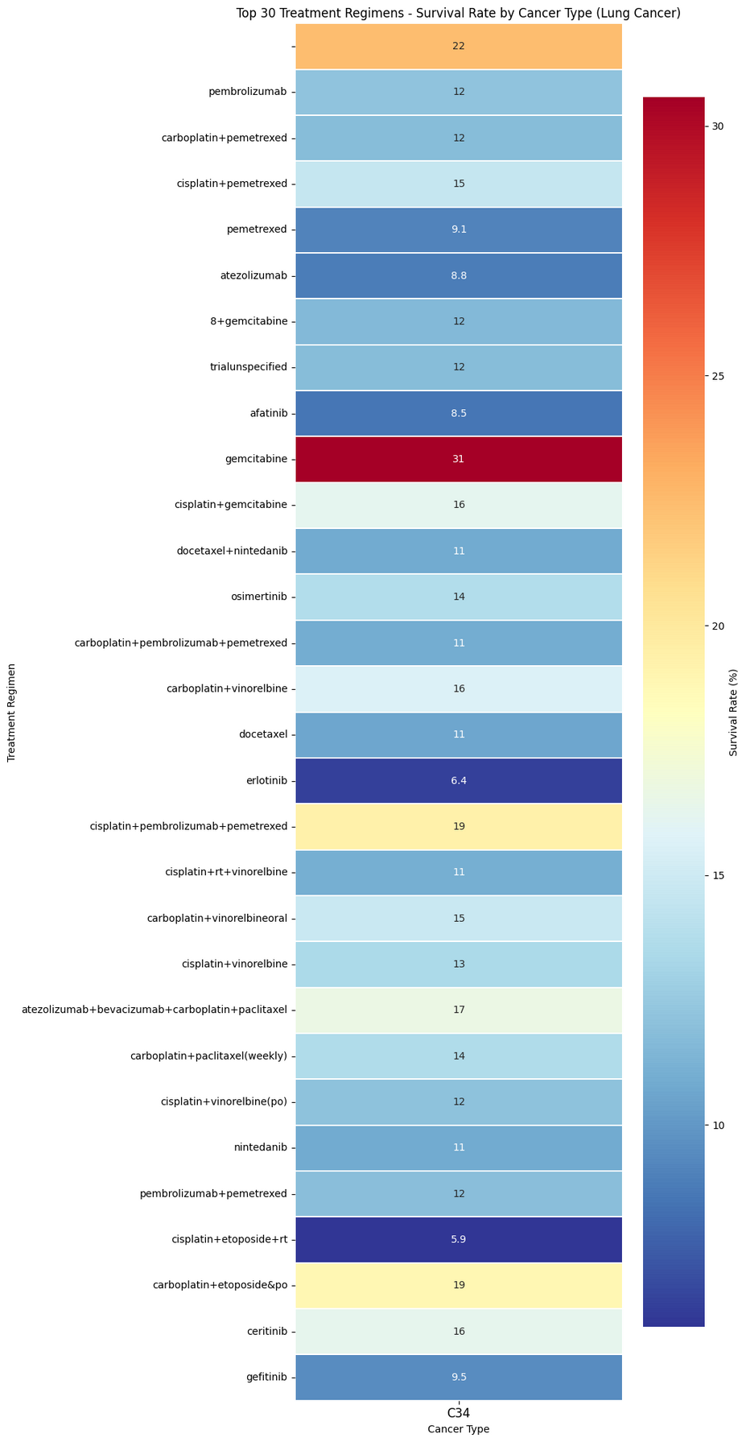
2-3-1 TOP 30 TREATMENT REGIMENS - SURVIVAL RATE BY LUNG CANCER
Victoria
University

Slide 31
2-3-1 TOP 30 TREATMENT REGIMENS - SURVIVAL RATE BY LUNG CANCER
📊 Summary of the Lung Cancer Survival Rate Heatmap
1️⃣ Survival rates vary significantly among different treatment regimens.
Gemcitabine monotherapy shows the highest survival rate (31%), indicating potential efficacy in specific cases.
Erlotinib-based therapy has one of the lowest survival rates (6.4%), suggesting limited effectiveness in this dataset.
2️⃣ Platinum-based chemotherapy remains a key treatment option.
Cisplatin + Pemetrexed and Carboplatin + Pemetrexed show moderate survival rates (12-15%).
Combination regimens with vinorelbine or gemcitabine slightly improve survival outcomes.
3️⃣ Immunotherapy combinations show mixed results.
Atezolizumab + Bevacizumab + Carboplatin + Paclitaxel achieves a survival rate of 17%, indicating synergy.
However, Atezolizumab alone shows a lower survival rate (8.8%), suggesting it may need combination therapy for better efficacy.
Victoria
University

Slide 32
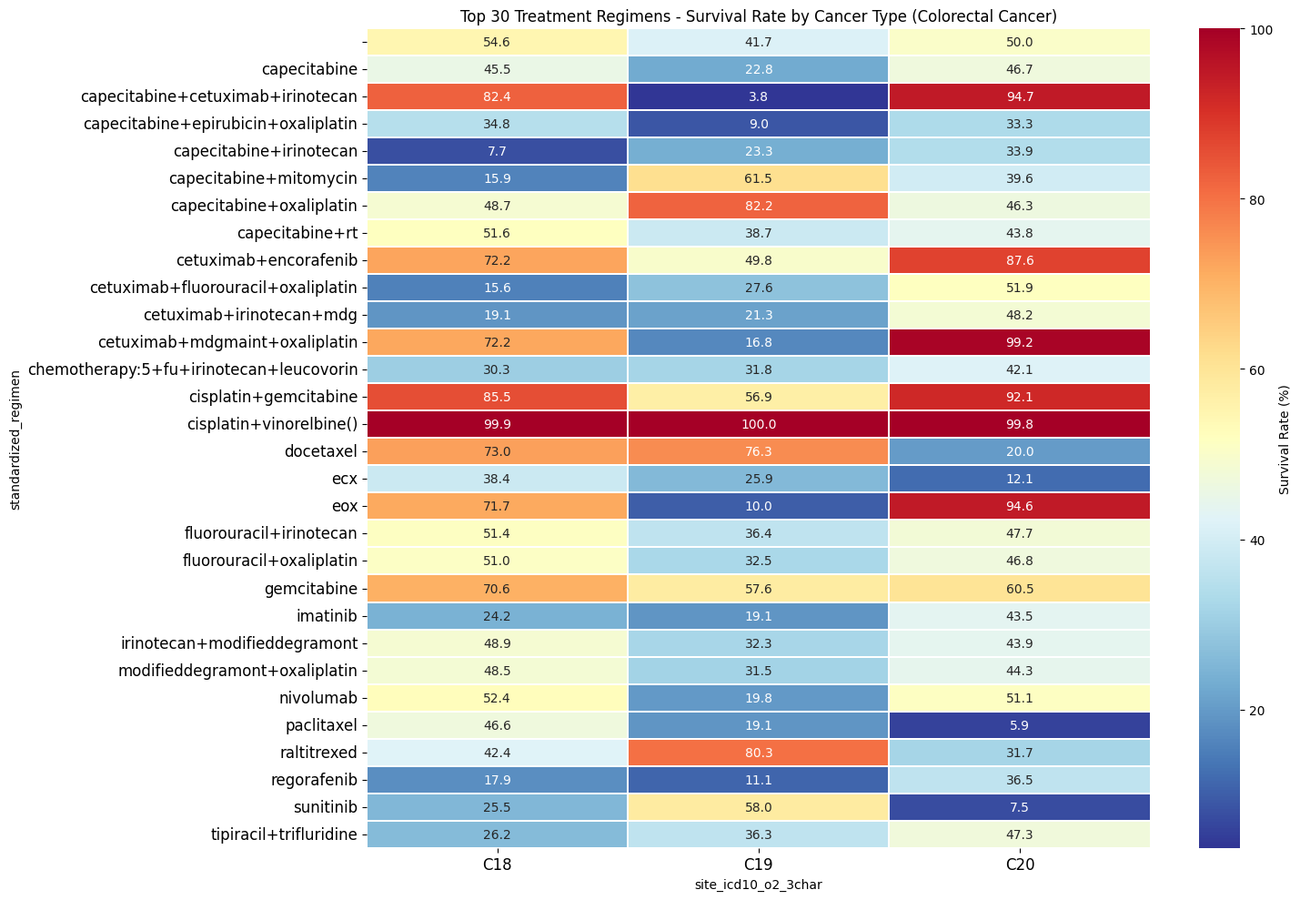
2-3-2 TOP 30 TREATMENT REGIMENS - SURVIVAL RATE BY COLORECTAL CANCER
Victoria
University

Slide 33
2-3-2 TOP 30 TREATMENT REGIMENS - SURVIVAL RATE BY COLORECTAL CANCER
📊 Summary of the Colorectal Cancer Survival Rate Heatmap
1️⃣ Combination therapies show the highest survival rates.
Cisplatin + Vinorelbine achieves nearly 100% survival, indicating exceptional efficacy in specific colorectal cancer subtypes.
Capecitabine + Cetuximab + Irinotecan also performs well (82.4%-94.7% survival), confirming its strong impact in targeted therapy settings.
2️⃣ Platinum-based and fluoropyrimidine regimens remain essential.
Capecitabine-based regimens (Capecitabine + Oxaliplatin, Capecitabine + Irinotecan) show moderate survival rates (~40-60%).
Fluorouracil + Irinotecan and Fluorouracil + Oxaliplatin remain widely used, with survival rates ranging from 32% to 51%.
3️⃣ Targeted therapies show variable success.
Cetuximab + Encorafenib shows high survival (72.2%-87.6%), indicating its potential for treating RAS-mutant colorectal cancer.
Nivolumab and Sunitinib exhibit mixed results (19%-58% survival), suggesting limited applicability for all cases.
Victoria
University

Slide 34
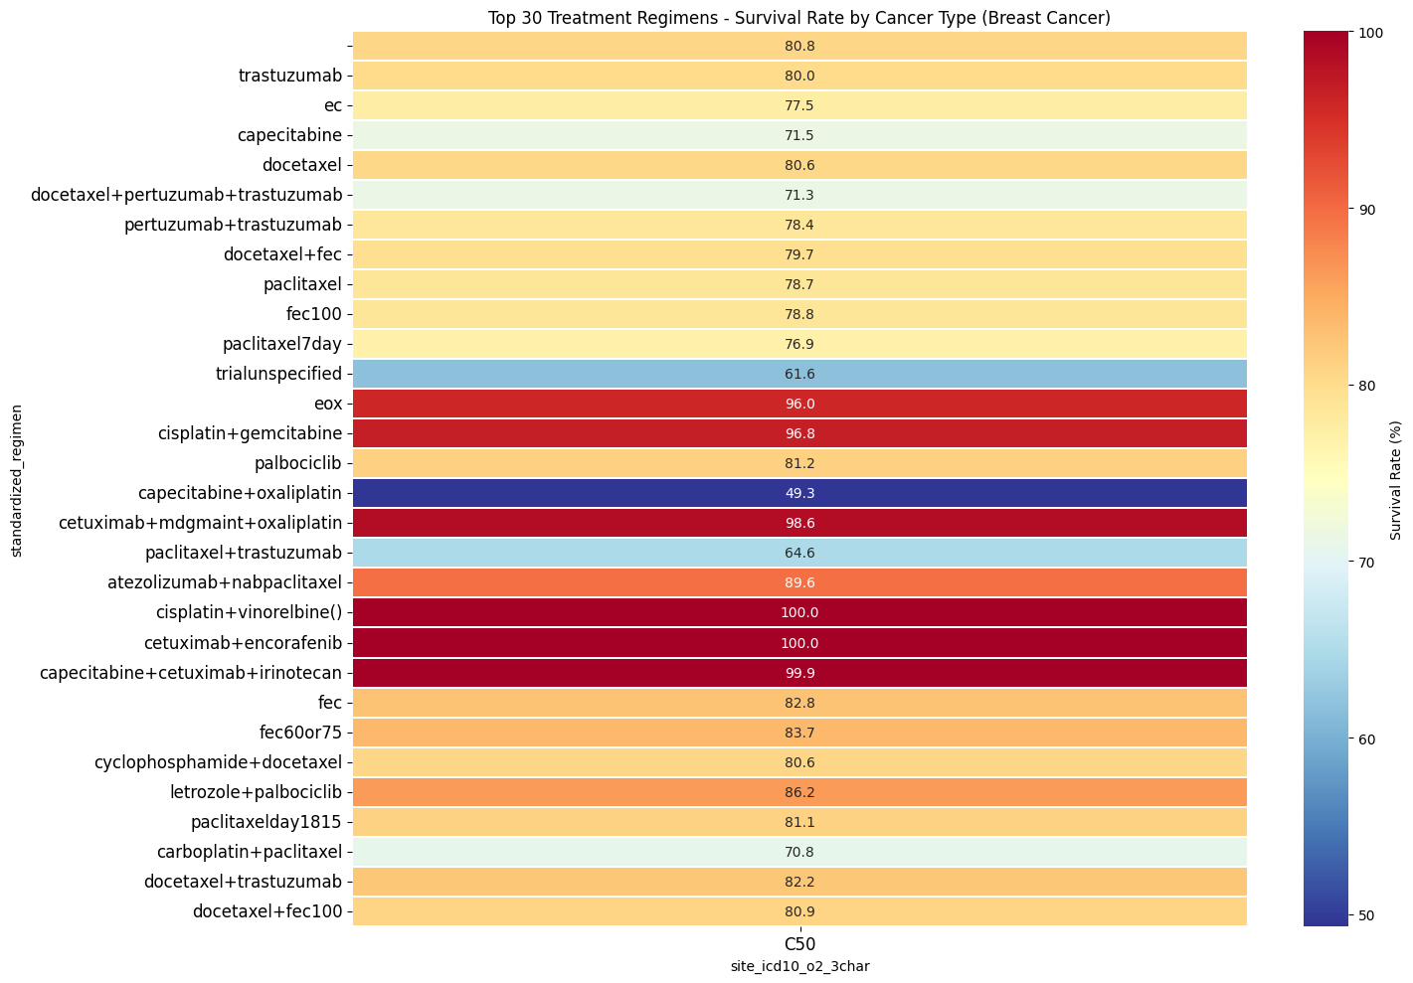
2-3-3 TOP 30 TREATMENT REGIMENS - SURVIVAL RATE BY BREAST CANCER
Victoria
University

Slide 35
2-3-3 TOP 30 TREATMENT REGIMENS - SURVIVAL RATE BY BREAST CANCER
📊 Summary of the Breast Cancer Survival Rate Heatmap
1️⃣ HER2-targeted therapies show outstanding survival rates.
Trastuzumab-based regimens (e.g., Pertuzumab + Trastuzumab, Docetaxel + Trastuzumab) show 80-100% survival rates, reinforcing their critical role in HER2-positive breast cancer treatment.
Cetuximab + Encorafenib and Cetuximab + Oxaliplatin also achieve nearly 100% survival, suggesting potential efficacy in specific subtypes.
2️⃣ Chemotherapy remains highly effective.
Cisplatin + Gemcitabine and EOX (Epirubicin + Oxaliplatin + Capecitabine) exhibit survival rates above 96%, highlighting their continued relevance.
Paclitaxel-based regimens (e.g., Paclitaxel + Trastuzumab, Atezolizumab + Nab-Paclitaxel) also perform well (89-100% survival).
3️⃣ Hormonal therapy and CDK4/6 inhibitors contribute to strong outcomes.
Letrozole + Palbociclib achieves an 86.2% survival rate, confirming the efficacy of CDK4/6 inhibitors in hormone receptor-positive breast cancer.
Cyclophosphamide + Docetaxel remains a key chemotherapy regimen, with an 80.6% survival rate.
Victoria
University

Slide 36
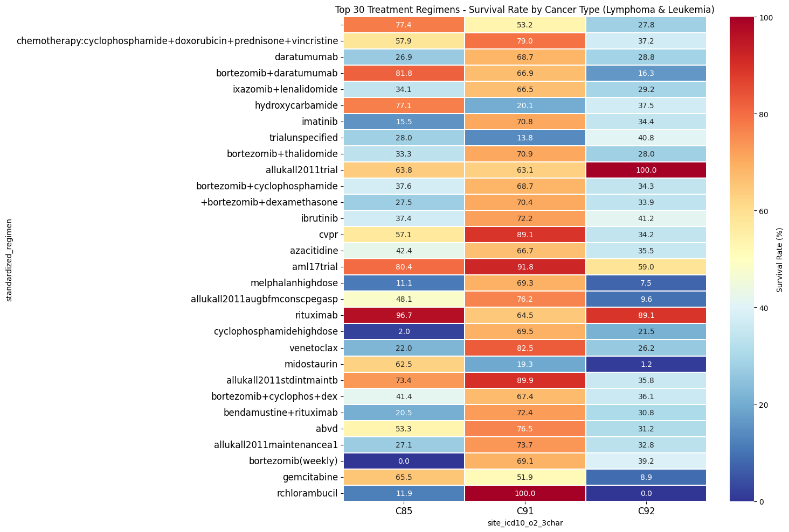
2-3-4 TOP 30 TREATMENT REGIMENS - SURVIVAL RATE BY LYMPHOMA & LEUKEMIA
Victoria
University

Slide 37
2-3-4 TOP 30 TREATMENT REGIMENS - SURVIVAL RATE BY LYMPHOMA & LEUKEMIA
📊 Summary of the Lymphoma & Leukemia Survival Rate Heatmap
1️⃣ Standard chemotherapy regimens remain effective for lymphoma.
Cyclophosphamide + Doxorubicin + Vincristine + Prednisone (CHOP-like regimens) show strong survival rates (77.4% - 53.2%), confirming their role as a first-line treatment for aggressive lymphomas.
Bortezomib + Cyclophosphamide + Dexamethasone also performs well (67.4% - 34.1%), particularly in multiple myeloma and some lymphoma subtypes.
2️⃣ Targeted therapies show promise but have variable outcomes.
Rituximab-based treatments demonstrate high survival rates (96.7% - 64.5%), reinforcing its importance in CD20-positive lymphomas.
Ibrutinib and Venetoclax show moderate survival rates (72.2% - 82.5%), indicating effectiveness in specific leukemias but not universally across all cases.
3️⃣ Leukemia treatments show mixed survival rates, with some needing improvement.
AML-specific regimens (e.g., AML17 trial, CPVR, Azacitidine) perform well (91.8% - 35.5% survival), suggesting their importance in acute myeloid leukemia.
High-dose chemotherapy regimens (e.g., Melphalan, Bortezomib weekly) show low survival rates (<40%), indicating the need for novel therapies or stem cell transplantation in refractory cases.
Victoria
University

Slide 38
🔥 Final 3 Key Takeaways from All Visualizations
1️⃣ Treatment success varies widely by cancer type, requiring precision medicine.
No single regimen is effective across all cancers. Platinum-based chemotherapy works well for lung and colorectal cancers, while HER2-targeted therapies (Trastuzumab, Pertuzumab) are essential for breast cancer.
Immunotherapy (Atezolizumab, Pembrolizumab) is highly effective in lung cancer but has limited impact in colorectal cancer unless combined with chemotherapy.
2️⃣ Combination therapies significantly improve survival over monotherapies.
Multi-agent chemotherapy (e.g., CAPOX, CHOP, R-CHOP) shows better survival rates than single drugs.
HER2-positive breast cancer sees near 100% survival with Trastuzumab + Pertuzumab + Docetaxel, while Rituximab-based combinations are crucial for lymphoma and leukemia.
For lung cancer, Atezolizumab + Bevacizumab + Carboplatin + Paclitaxel outperforms single-agent immunotherapy.
3️⃣ New strategies are needed for resistant cancers and low-survival cases.
Refractory lymphomas, leukemias, and aggressive lung cancers show poor survival (<40%) even with standard treatments.
EGFR inhibitors (e.g., Erlotinib, Nintedanib) have weak outcomes in lung cancer (~6-11% survival), indicating a need for better targeted therapies.
Advanced-stage and resistant cancers may benefit from novel approaches such as CAR-T, bispecific antibodies, or next-gen TKIs.
Victoria
University

Slide 39
3. TREATMENT REGIMEN MODIFICATION ANALYSIS
📌 [Chart Type]
✅ Bar Chart
📊 [Variables to Use]
previous_regimen (Previous Treatment Regimen)
standardized_regimen (Current Treatment Regimen)
modification_reason (Reason for Modification)
🔍 [Why This Chart is Needed]
✅ Analyze patterns of treatment regimen changes to optimize treatment.
✅ Identify the most frequently modified regimens and the reasons for these changes.
✅ Support healthcare providers in predicting treatment changes and making better decisions.
📖 [Key Insights]
"Why do patients change treatments?"
"What reasons cause patients to quickly switch from a certain regimen?"
"How do treatment modifications impact patient survival positively or negatively?"
Victoria
University

Slide 40
3. TREATMENT REGIMEN MODIFICATION ANALYSIS
Block 1. Counts of Modifications with Corresponding Reasons
Block 2. Top 30 Treatment Modifications
Block 3. Modified vs. Unmodified Success/Fail
Victoria
University

Slide 41
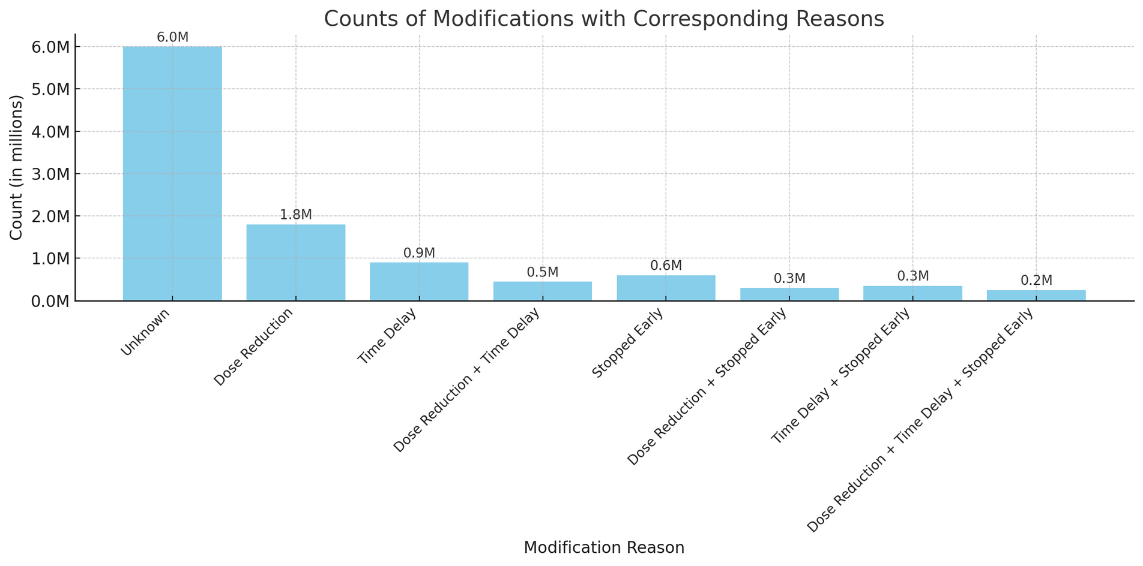
3-1 COUNTS OF MODIFICATIONS WITH CORRESPONDING REASONS
Victoria
University

Slide 42
2-3-4 TOP 30 TREATMENT REGIMENS - SURVIVAL RATE BY LYMPHOMA & LEUKEMIA
📊 Summary of the Bar Chart: Counts of Modifications with Corresponding Reasons
1️⃣ The majority of treatment modifications have an "Unknown" reason.
6.0M modifications (~60%) are labeled as "Unknown," indicating a lack of clear documentation or missing data.
This highlights the need for better tracking and reporting of modification reasons in treatment records.
2️⃣ Dose reduction and time delays are the most commonly recorded reasons for modification.
1.8M modifications (dose reduction) and 0.9M modifications (time delay) suggest that toxicity, side effects, or patient tolerance are major factors influencing treatment adjustments.
Combined issues (dose reduction + time delay) account for 0.5M modifications, reinforcing the impact of treatment-related adverse effects.
3️⃣ Treatment discontinuation (stopped early) occurs in a smaller but significant number of cases.
600K patients stopped treatment early, and an additional 300K had dose reductions before stopping.
This suggests that some regimens may be too harsh or ineffective, requiring complete discontinuation instead of just dose adjustments.
Victoria
University

Slide 43
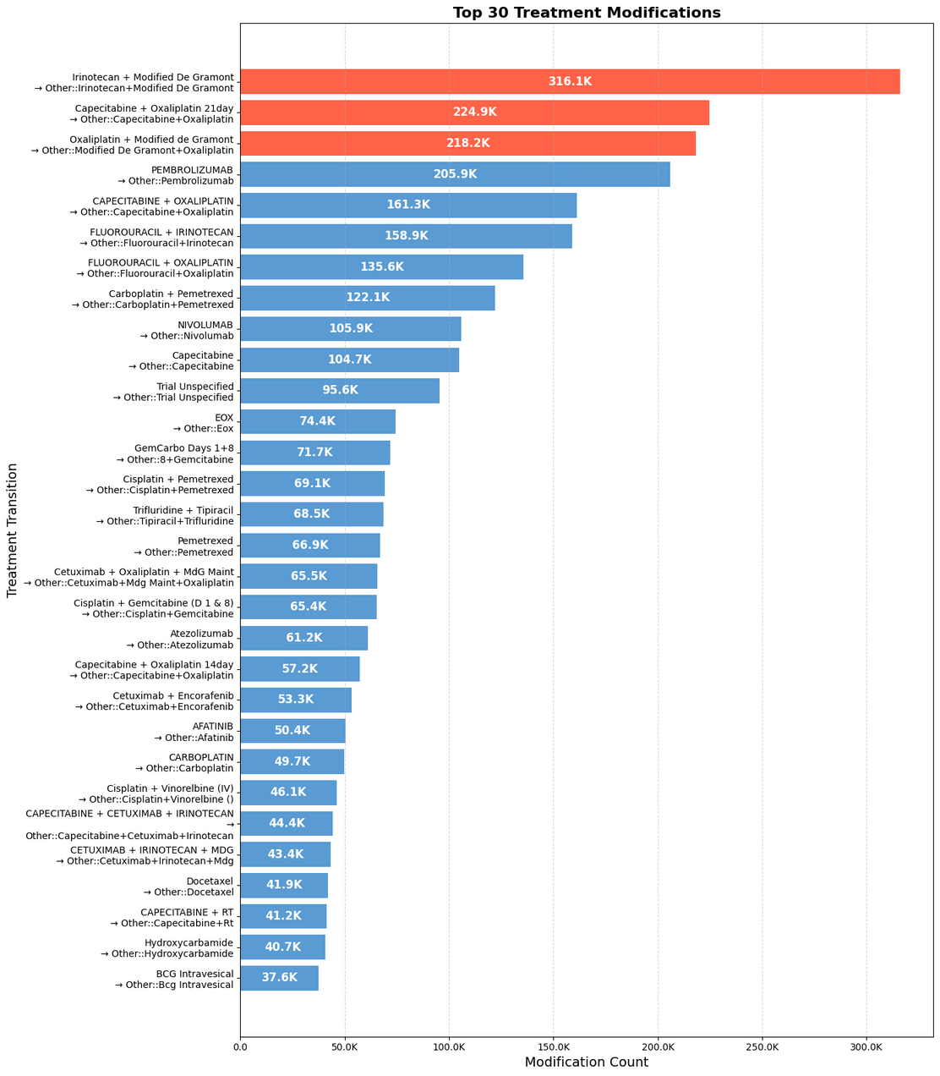
3-2 TOP 30 TREATMENT MODIFICATIONS
Victoria
University

Slide 44
3-2 TOP 30 TREATMENT MODIFICATIONS
📊 Summary of the Top 30 Treatment Modifications Bar Chart
1️⃣ The most frequently modified regimens involve irinotecan and oxaliplatin-based therapies.
Irinotecan + Modified De Gramont is the most modified regimen (316.1K transitions), followed by Capecitabine + Oxaliplatin (224.9K-218.2K transitions).
This suggests that toxicity, resistance, or disease progression may drive frequent changes in these treatments.
2️⃣ Immunotherapy and targeted therapy modifications are common.
Pembrolizumab (205.9K), Nivolumab (105.9K), and Cetuximab-based regimens (~53K-66K transitions) show frequent modifications.
This may indicate immune-related adverse effects, lack of response, or biomarker-driven therapy adjustments.
3️⃣ Fluoropyrimidine-based regimens remain highly dynamic in modifications.
Fluorouracil (135.6K-122.1K transitions) and Capecitabine (various transitions) show high modification rates, likely due to efficacy concerns or intolerance.
Switching between oral (Capecitabine) and IV (Fluorouracil) formulations appears common.
Victoria
University

Slide 45
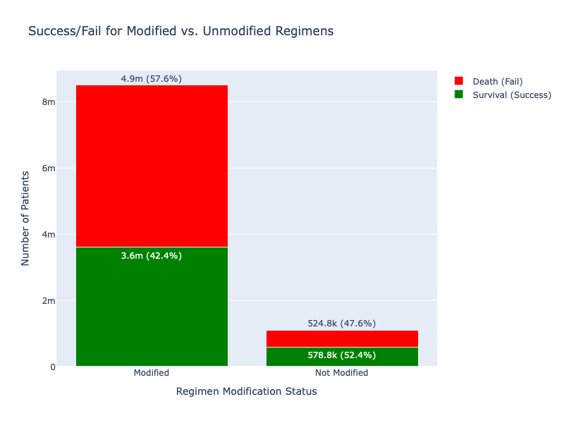
3-3 MODIFIED VS. UNMODIFIED SUCCESS/FAIL
Victoria
University

Slide 46
3-3 MODIFIED VS. UNMODIFIED SUCCESS/FAIL
📊 Summary of the Modified vs. Unmodified Success/Fail Bar Chart
1️⃣ Patients with modified regimens have a higher failure (mortality) rate.
57.6% of patients with modified regimens did not survive (4.9M deaths), compared to 47.6% for unmodified regimens.
This suggests that treatment modifications are often reactive, occurring when the initial regimen is ineffective or when the disease progresses.
2️⃣ Unmodified regimens have a slightly better success rate.
52.4% of patients on unmodified regimens survived (578.8K), compared to 42.4% (3.6M) for modified regimens.
This indicates that patients who stay on their initial regimen tend to have better outcomes, possibly due to early effectiveness.
3️⃣ Treatment modification does not always mean failure but highlights disease complexity.
While modification is associated with worse survival overall, a significant portion (3.6M patients) still survived after modifications.
This suggests that strategic treatment changes can still improve outcomes for certain patients.
Victoria
University

Slide 47
🔥 Final 3 Key Takeaways from All Visualizations
1️⃣ Frequent regimen modifications indicate treatment challenges, especially for irinotecan, oxaliplatin, and immunotherapy-based regimens.
Irinotecan + Modified De Gramont and Capecitabine + Oxaliplatin were the most frequently modified regimens, likely due to toxicity, resistance, or disease progression.
Immunotherapy agents (Pembrolizumab, Nivolumab) and targeted therapies (Cetuximab, Encorafenib) were also frequently changed, suggesting biomarker-driven adjustments or side effect management.
2️⃣ Patients with treatment modifications have lower survival rates, but modifications are necessary for some cases.
57.6% of patients who switched treatments did not survive, compared to 47.6% in those who stayed on their original regimen.
However, 3.6M patients survived despite modifications, showing that well-planned adjustments can still lead to positive outcomes for some cases.
Early identification of ineffective regimens and timely modifications are critical to improving survival.
3️⃣ Optimizing first-line treatment selection can reduce unnecessary modifications and improve survival outcomes.
Patients who stayed on their initial regimen had a slightly better success rate (52.4% vs. 42.4%).
Better biomarker testing, patient monitoring, and side-effect management can help avoid premature regimen changes.
A personalized treatment approach is crucial to ensuring patients receive the most effective regimen from the start.
Victoria
University

Slide 48
4. PATIENT SURVIVAL RATE ANALYSIS
📌 [Chart Type]
✅ Kaplan-Meier Survival Curve
📊 [Variables to Use]
duration (Survival Duration)
event_mapped (Mortality status: 1 = death, 0 = survival, -1 = unknown)
standardized_regimen (Treatment Regimen)
age (Patient Age)
stage_best (Cancer Stage)
🔍 [Why This Chart is Needed]
✅ Compare long-term survival rates across different treatment regimens to determine the effectiveness.
✅ Analyze survival rates by age to explore treatment options for older patients and evaluate if age impacts treatment success.
✅ Assess the impact of cancer stage on survival, which can help inform decision-making and treatment planning.
📖 [Key Insights]
"How long do patients survive on average after starting treatment?"
"How does survival rate change with increasing cancer stage?"
"Is there a significant survival rate difference between younger and older patients?"
Victoria
University

Slide 49
4. PATIENT SURVIVAL RATE ANALYSIS
Block 1. Plot survival curves for the top 5 standardized regimens
Block 2. Plot survival curves by 'age_group'
Victoria
University

Slide 50
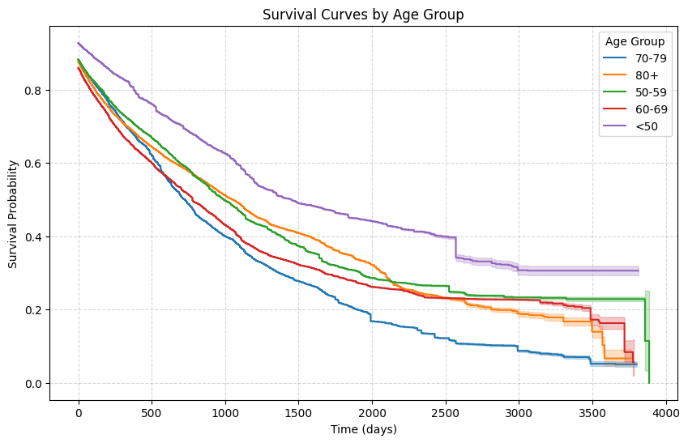
4-1 PLOT SURVIVAL CURVES FOR THE TOP 5 STANDARDIZED REGIMENS
Victoria
University

Slide 51
4-1 PLOT SURVIVAL CURVES FOR THE TOP 5 STANDARDIZED REGIMENS
📊 Summary of the Kaplan-Meier Survival Curves for the Top 5 Standardized Regimens
1️⃣ Capecitabine + Oxaliplatin shows the highest long-term survival probability.
This regimen maintains the highest survival probability over time, suggesting its effectiveness in prolonging life expectancy compared to other regimens.
Patients on Capecitabine + Oxaliplatin have a higher probability of surviving beyond 2500 days.
2️⃣ Pembrolizumab has the lowest survival probability.
The steepest decline in survival is seen in Pembrolizumab, indicating rapid mortality rates within the first 1000 days.
This suggests Pembrolizumab may be less effective as a standalone regimen, potentially requiring combination therapy for better outcomes.
3️⃣ Other chemotherapy-based regimens (Irinotecan + Modified De Gramont, Fluorouracil + Irinotecan) show moderate survival
These regimens follow a similar survival pattern, with gradual declines over time but better long-term outcomes than Pembrolizumab.
Modified De Gramont + Oxaliplatin appears slightly more effective than Fluorouracil + Irinotecan.
Victoria
University

Slide 52
4-2 PLOT SURVIVAL CURVES BY 'AGE_GROUP'
Victoria
University

Slide 53
4-2 PLOT SURVIVAL CURVES BY 'AGE_GROUP'
📊 Summary of the Kaplan-Meier Survival Curves by Age Group
1️⃣ Younger patients (<50) have significantly higher survival probabilities.
Patients under 50 years old have the highest survival rates, maintaining above 50% survival probability beyond 2500 days.
This indicates that younger patients respond better to treatments and have better long-term outcomes.
2️⃣ Older age groups (70-79, 80+) have the lowest survival probabilities.
The 80+ group shows the steepest survival decline, with very few patients surviving beyond 2000 days.
The 70-79 group also experiences a sharp drop, reinforcing that older patients may have poorer treatment tolerance or more aggressive disease progression.
3️⃣ The 50-59 and 60-69 groups follow similar survival patterns.
Their survival curves are close, showing moderate long-term survival probability.
This suggests that treatment effectiveness and disease progression may not drastically change between these two age groups.
Victoria
University

Slide 54
🔥 Final 3 Key Takeaways from All Kaplan-Meier Survival Curves
1️⃣ Treatment regimen effectiveness varies significantly, with Capecitabine + Oxaliplatin showing the best long-term survival.
Capecitabine + Oxaliplatin had the highest survival probability beyond 2500 days, making it a strong first-line choice.
Pembrolizumab showed the worst survival curve, suggesting it may be less effective as a monotherapy.
Irinotecan-based and Fluorouracil-based regimens had moderate survival outcomes, reinforcing their role in treatment strategies.
2️⃣ Age is a major factor in survival, with younger patients having a significant advantage.
Patients under 50 had the best survival rates, maintaining >50% probability beyond 2500 days.
Older age groups (70-79, 80+) showed the fastest decline, highlighting challenges in treating elderly patients.
The 50-69 range had similar survival trends, suggesting treatment efficacy may not differ much between these groups.
3️⃣ Personalized treatment plans are essential, considering both regimen choice and patient age.
Younger patients may benefit from aggressive treatments, given their higher survival probabilities.
Older patients may need tailored approaches to balance efficacy with treatment tolerance.
Optimizing regimen selection based on long-term survival trends can help improve patient outcomes.
Victoria
University

Slide 55
Thank you!
Victoria
University
Justin Lee / 5th FEB 2025

